Slide 1
Formatting_Visualization&Analysis
File created on: 09-Nov-21 2:59:04 PM

Slide 2
Scenarios:
1.Find the profit and sales for each subcategory of every type of product.
2. Which subcategory has highest profit in the year 2019.
3. In case 1, change the color of the view from the Marks card.
4. In the view, in the Sub-Category filter card, clear all of the check boxes except Bookcases, Machines, and Tables to have closer look on each value.
5. Find out the key insights about in which year bookcases and machines were profitable and unprofitable.
6. Show the sales region wise for every subcategory and category and every year.
7. Duplicate your worksheet and check sales region vise for Machine type subcategory.
8. In which region you are reporting a higher negative profit overall than in your other regions.
9. Show your view for Sales in the South for all subcategory.
10. Which subcategory has highest overall negative profit in the south region.
11. Take some decisions to improve profit in the south.
12. Rename your worksheet.
13. Save your workbook.

Slide 3
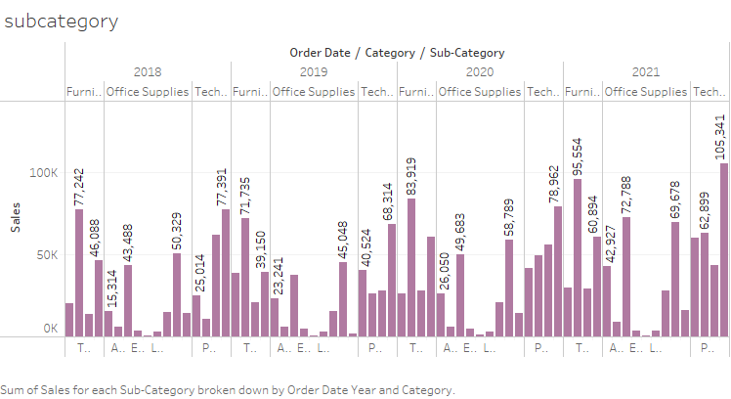
1.Find the profit and sales for each subcategory of every type of product.
3. In case 1, change the color of the view from the Marks card.

Slide 4
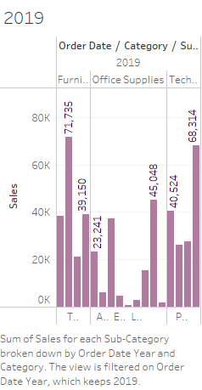
2. Which subcategory has highest profit in the year 2019.
The chairs subcategory is highest in 2019

Slide 5
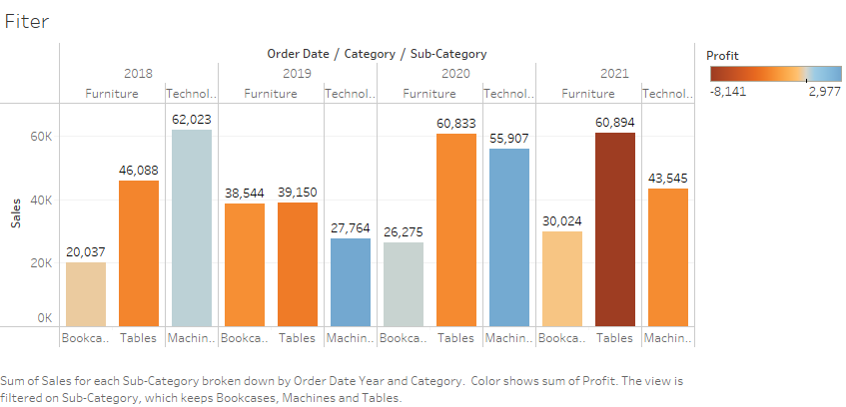
4. In the view, in the Sub-Category filter card, clear all of the check boxes except Bookcases,
Machines, and Tables to have closer look on each value.

Slide 6
5. Find out the key insights about in which year bookcases and
machines were profitable and unprofitable.
Ans-
In 2018 machine is profitable and 2021 is unprofitable.
In 2020 Bookcases is profitable and 2019 is unprofitable.

Slide 7
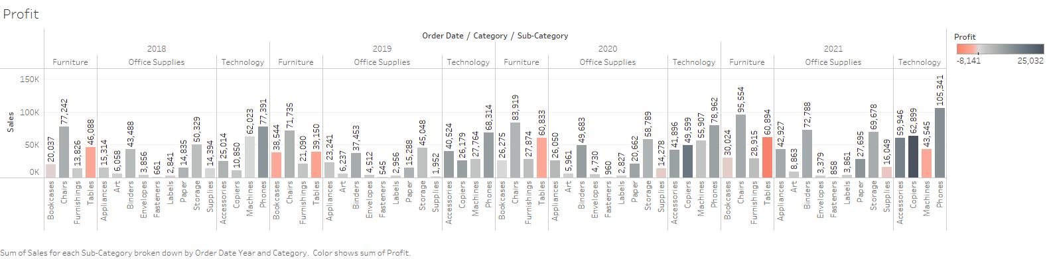

Slide 8
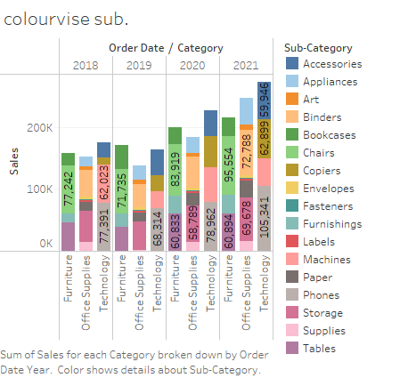

Slide 9
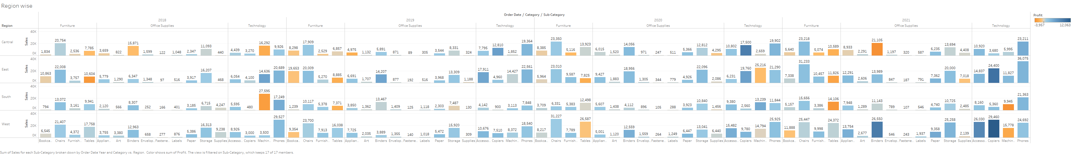
Show the sales region wise for every subcategory and category and every year.

Slide 10
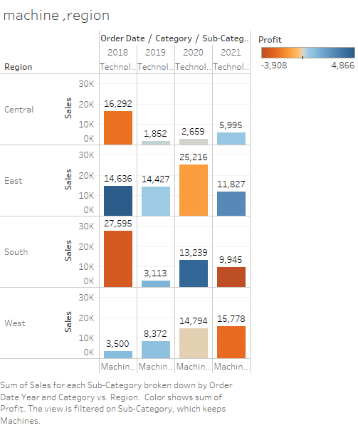
Duplicate your worksheet and check sales region vise for Machine type subcategory.

Slide 11
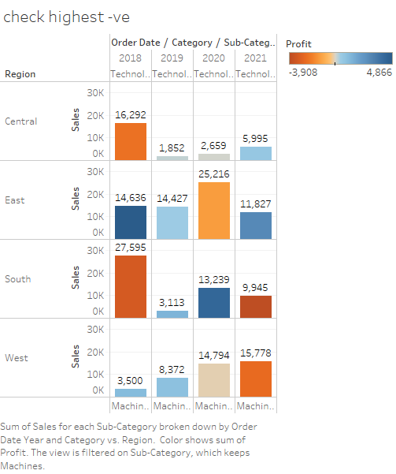
In which region you are reporting a higher negative profit overall than in your other regions.
Ans – In south region

Slide 12
9. Show your view for Sales in the South for all subcategory.
10. Which subcategory has highest overall negative profit in the south region.
11. Take some decisions to improve profit in the south.
12. Rename your worksheet.
13. Save your workbook.

Slide 13
10. Which subcategory has highest overall negative profit in the south region.
Ans- Machine is a highest negative profit in south region.
11. Take some decisions to improve profit in the south.
Ans- Give more offer on negative profit then increase the profit
12. Rename your worksheet.
Ans- file – right click- Rename
13. Save your workbook.
Ans –Go to file and click save

